Slide 1

Kepler Objects of Interest: Candidate inference
Statistical Inference and Learning
Davide Tonetto (884585)
2024/2025

Slide 2
Project overview
Objective: Predict if a Kepler Object of Interest (KOI) is a Planetary Candidate or False Positive.
Dataset: NASA’s Kepler DR25 (Q1–Q17) KOI table. Link for download: exoplanetarchive.ipac.caltech.edu
Method: Statistical modeling and dimensionality reduction.
Goal: Build accurate and interpretable models using astrophysical features.

Slide 3
What are Kepler Object of interest (KOI)?
Definition of KOI: A target star observed by NASA’s Kepler space telescope that exhibits transit-like signals.
Transit-like Signals: These signals suggest an object passing in front of the star, potentially an exoplanet.
KOI Designation Meaning: Represents a candidate detection requiring further investigation, not a confirmed planet.
Vetting Process: Rigorous analysis of data and follow-up observations to classify KOIs into definitive categories.
KOI Classification: Planetary Candidate (PC), False Positive (FP), or Confirmed Planet based on vetting results.

Slide 4
The dataset
Dataset Source: Kepler Object of Interest (KOI) dataset from NASA’s Exoplanet Archive.
Dataset Selection Rationale: Q1-Q17 Data Release 25 (DR25) Kepler Objects of Interest (KOI) table.
Reason for Choosing Q1-Q17 DR 25 KOI Table: Rigorous, automated, and uniform classification methodology, ensuring data homogeneity for robust statistical analysis.
Benefit of Homogeneous Data: Enables the training of reliable statistical and machine learning models for predicting exoplanets.

Slide 5
Target variable
koi_pdisposition is the target for classification.
Labels:
CANDIDATE: The signal passed automated vetting tests and remains consistent with a transiting planet.
FALSE POSITIVE: Signal failed vetting, suggesting non-planetary cause.
Human-validated label (koi_disposition) not used to ensure consistency.

Slide 6
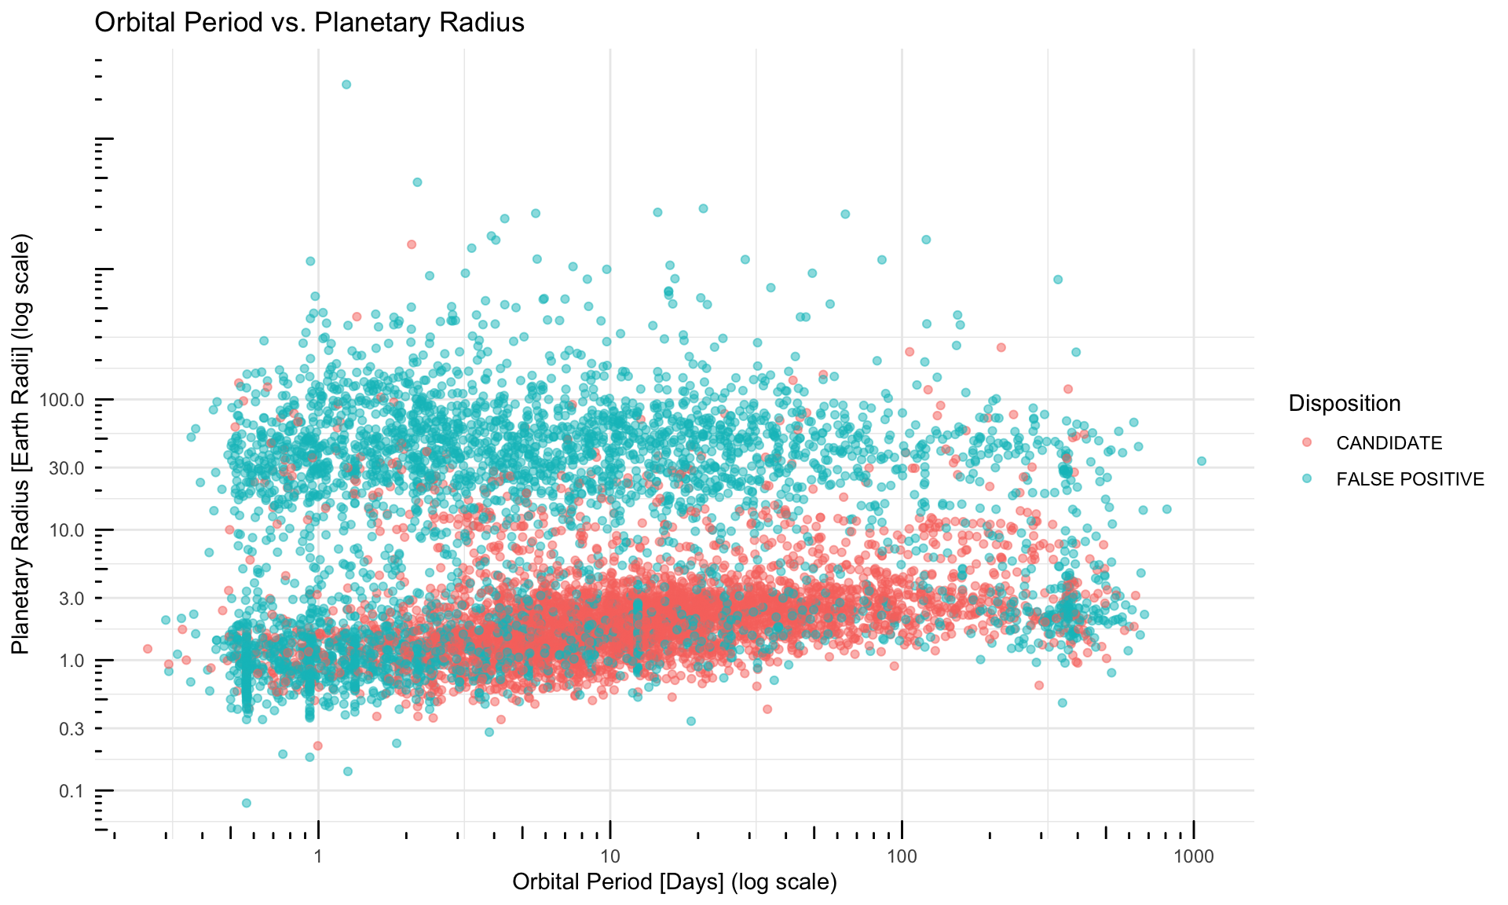
Orbital Period vs. Planetary Radius
The plot shows planet radius against orbital period, highlighting exoplanet populations and false positives.

Slide 7
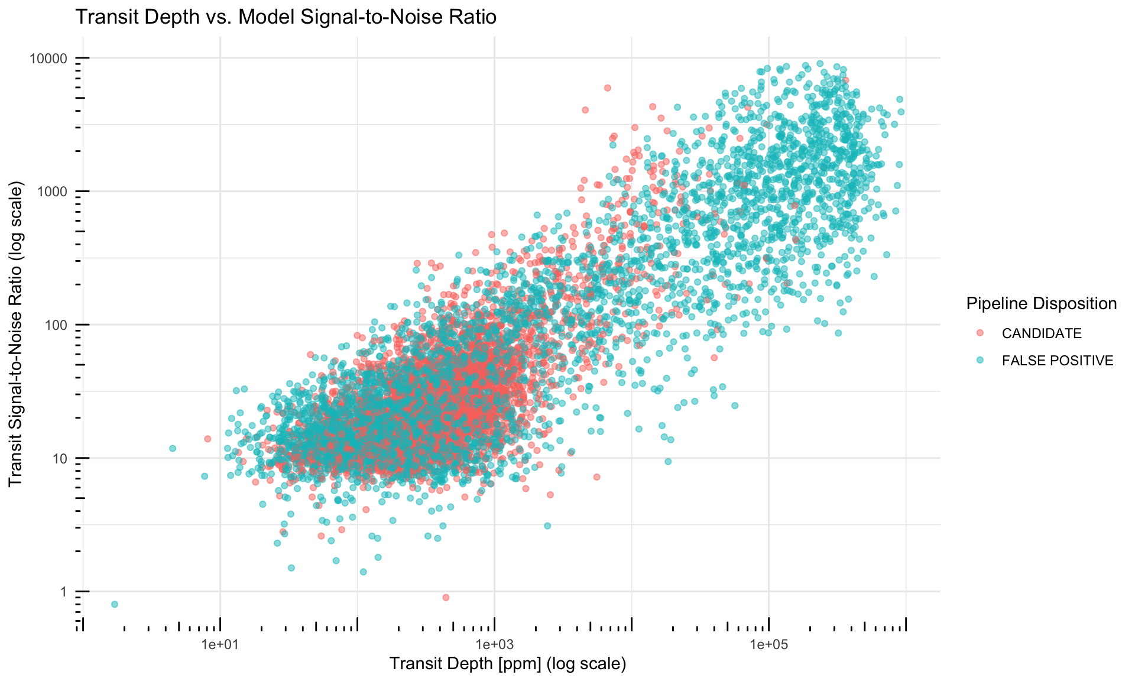
Transit Depth vs. Model Signal-to-Noise Ratio
Transit depth and SNR are positively correlated, with deeper transits being easier to detect.
The plot visualizes false positives and candidates spanning a wide range of depths and SNRs.

Slide 8
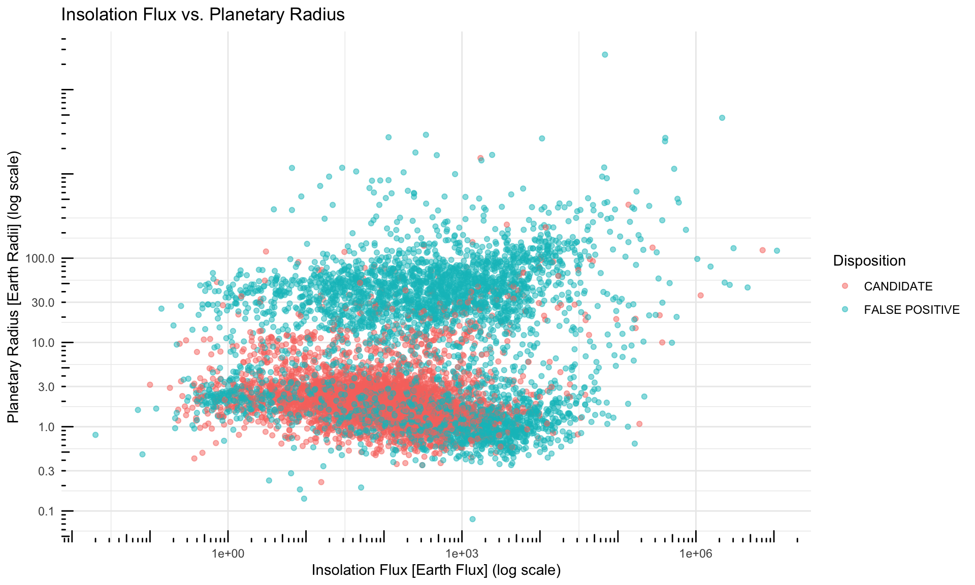
Insolation Flux vs. Planetary Radius
The plot examines the relationship between planetary energy receipt, size, and insolation, potentially identifying false positives based on these parameters.

Slide 9
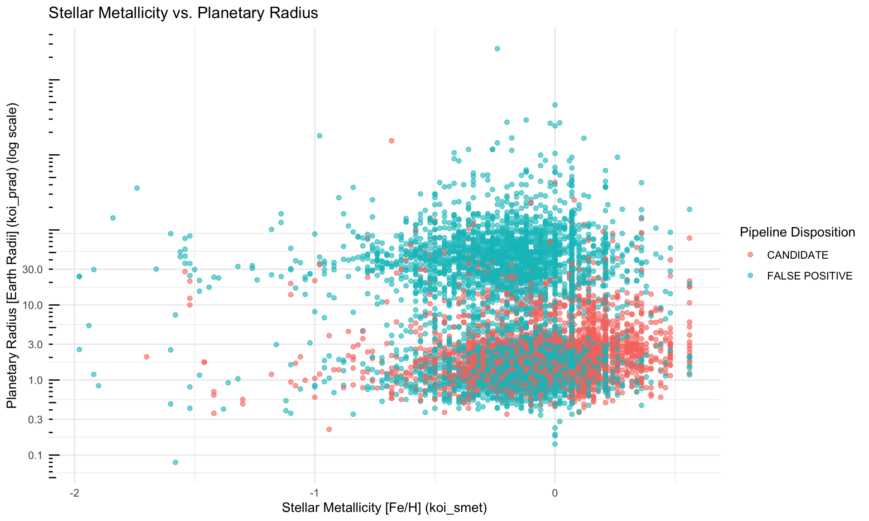
Stellar Metallicity vs. Planetary Radius
The plot investigates the relationship between planet size and star metallicity.

Slide 10
Data processing techniques
Imputation: Median/mode after train-test split
Feature Scaling: Standardized using training data
Outlier Removal: Based on Cook’s Distance > 0.5
Collinearity Handling: Removed features with VIF > 10

Slide 11
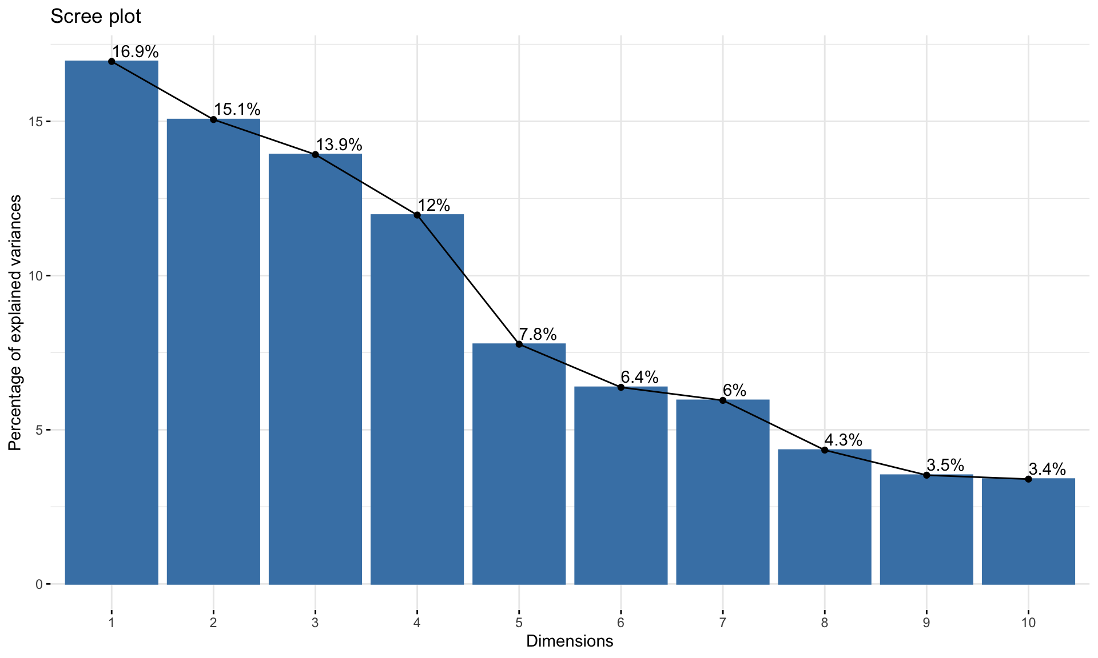
Principal component analysis
PCA applied to reduce dimensionality.
First 2 PCs explain only 32% of variance.
~11 PCs needed to capture 90%+.
Interpretation of PCs:
PC1: Orbital + thermal features
PC2: Stellar temperature + orbit
PC4: Planet size + transit geometry
PC5: Transit depth and signal strength

Slide 12
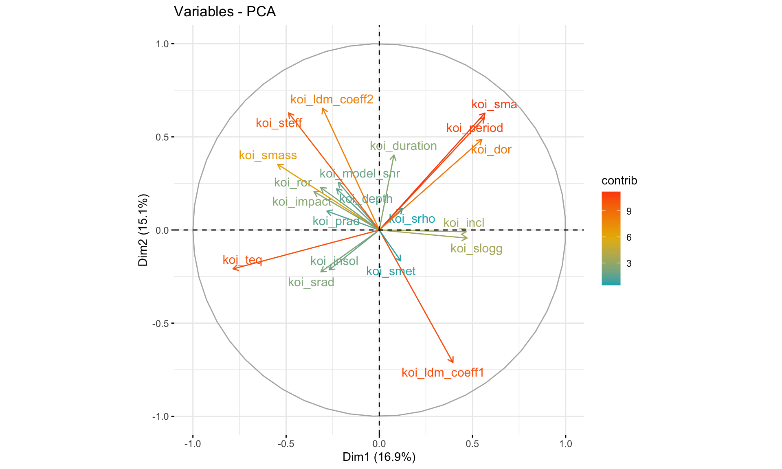
PCA Loadings
Loadings of the first two principal components allowing us to understand the relationship between the original variables and the principal components.

Slide 13
Modeling approach
Models tested:
GLM
GAM
GLM with interactions
Lasso
Ridge
PCA-based models (GLM, GAM, RF)
Evaluation metrics:
Accuracy
AUC (ROC)
Sensitivity
Specificity

Slide 14
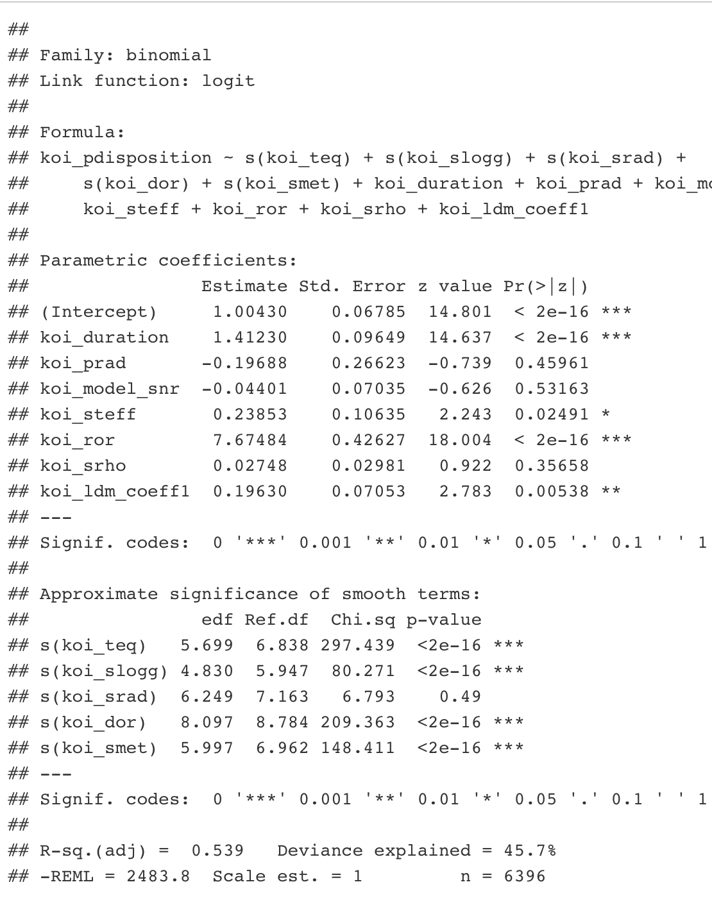
Interpretation of the GAM model
Intercept Significance: The baseline log-odds of a KOI being a “false_positive” is highly significant.
Transit Duration Impact: Longer transit durations significantly increase the log-odds of being a “false_positive”.
Stellar Effective Temperature Influence: Higher stellar effective temperature significantly increases the log-odds of being a “false_positive”.
Stellar Temperature and False Positives: Higher stellar temperatures are associated with a higher likelihood of being a false positive in the GAM model.
Planet-to-Star Radius Ratio: koi_ror has a very large and highly significant positive effect on the log-odds of being a “false_positive”, indicating a strong indicator of eclipsing binaries.
Limb Darkening Coefficient: The first limb darkening coefficient has a significant positive linear effect on the log-odds of being a “false_positive”.
Non-linear Relationships: Equilibrium temperature (koi_teq), stellar surface gravity (koi_slogg), and planet-star distance over star radius (koi_dor) have highly significant and complex non-linear relationships with the likelihood of being a “false_positive”.
Significance of Stellar Surface Gravity: Stellar surface gravity (koi_slogg) has a highly significant and non-linear effect on the likelihood of being a “false_positive”.
koi_ror as a Predictor: The planet-to-star radius ratio (koi_ror) is a strong linear predictor, with large values indicating a higher likelihood of a “false_positive”.

Slide 15
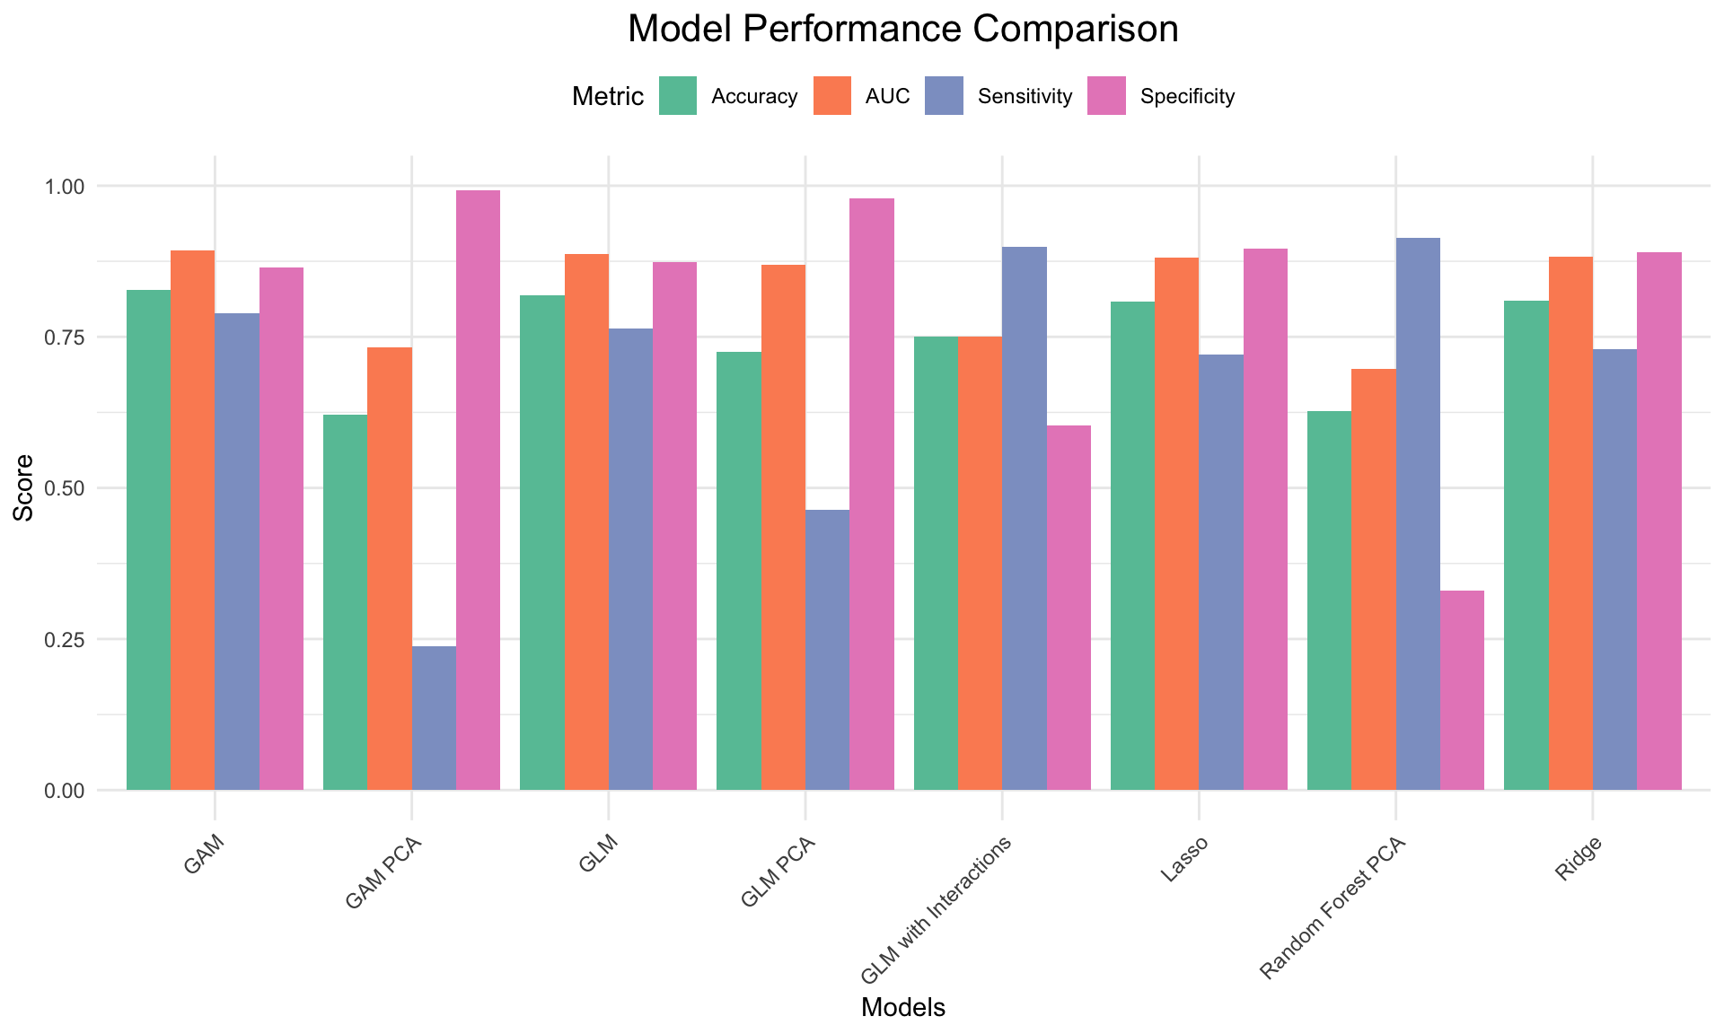
Model performance
Best Model: GAM
AUC = 0.893, Accuracy = 0.827
GLM also performed well (AUC = 0.888)
Lasso and Ridge: High specificity, slightly lower sensitivity
GLM with interactions: Overfit, worse performance
PCA models: Weaker overall

Slide 16
Models summary
Model Improvement: Iterative refinement of the GLM, including outlier removal and multicollinearity handling, led to an improved AIC and better model fit.
Predictors of False Positives: koi_duration, koi_depth, koi_teq, koi_slogg, koi_smass, koi_impact, koi_ror, and koi_dor were consistently associated with “FALSE POSITIVE” status.
Predictors of Candidates: Higher koi_insol, koi_steff, koi_incl, and koi_smet were associated with a higher likelihood of being a “CANDIDATE”.
Best Performing Model: Generalized Additive Model (GAM) achieved the highest AUC, Accuracy, Sensitivity, and Specificity due to its ability to capture non-linear relationships.
Model Interpretation: GAM revealed complex relationships between predictors like koi_teq, koi_slogg, koi_dor, and koi_smet, while koi_ror remained a strong linear predictor of “FALSE POSITIVEs”.
Performance of Other Models: GLM with Interaction Terms faced numerical issues, Lasso and Ridge Regression performed similarly, with Lasso performing feature selection.

Slide 17
conclusions
GAM with original features is the best model. It offers a nice interpretation fo the parameters along with the optimal scores.
PCA-based models underperformed — possible loss of interpretability and information.
Lasso/Ridge good alternatives if regularization is needed.
Threshold tuning could improve application-specific performance

